Slide 1
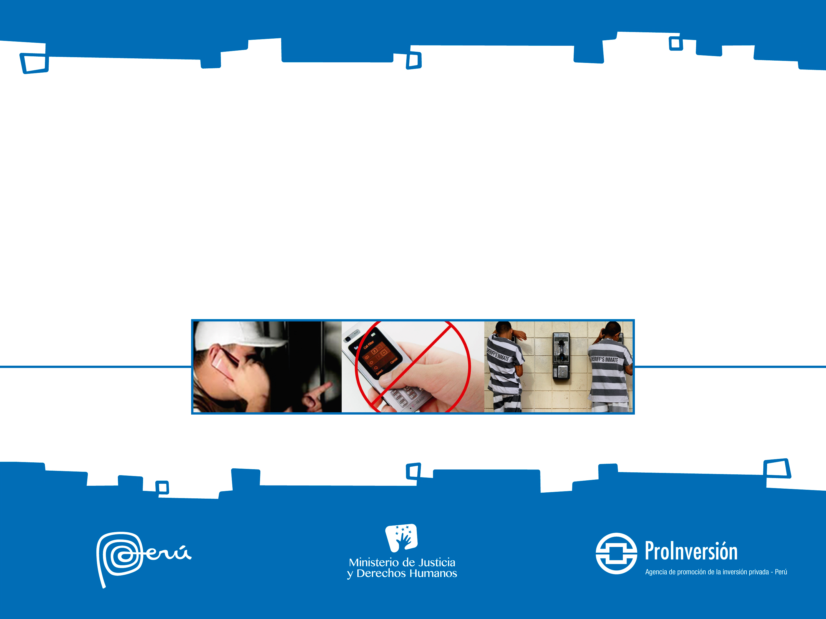
PROVISION OF TECHNOLOGICAL SECURITY SERVICES IN PENAL INSTITUTIONS

Slide 2
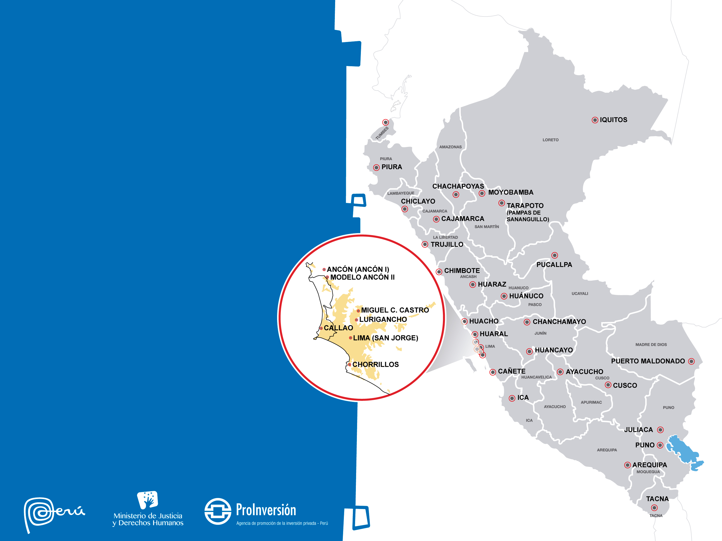
GENERAL OBJECTIVE
Provide communications' technological security in 33 prisons in Peru
SPECIFIC OBJETCIVES
Prevent that prisons will be origin of extortion trough phone calls to citizens, national or foreigners authorities resident in Peru.
To preserve and guarantee the right of inmates to communicate.

Slide 3
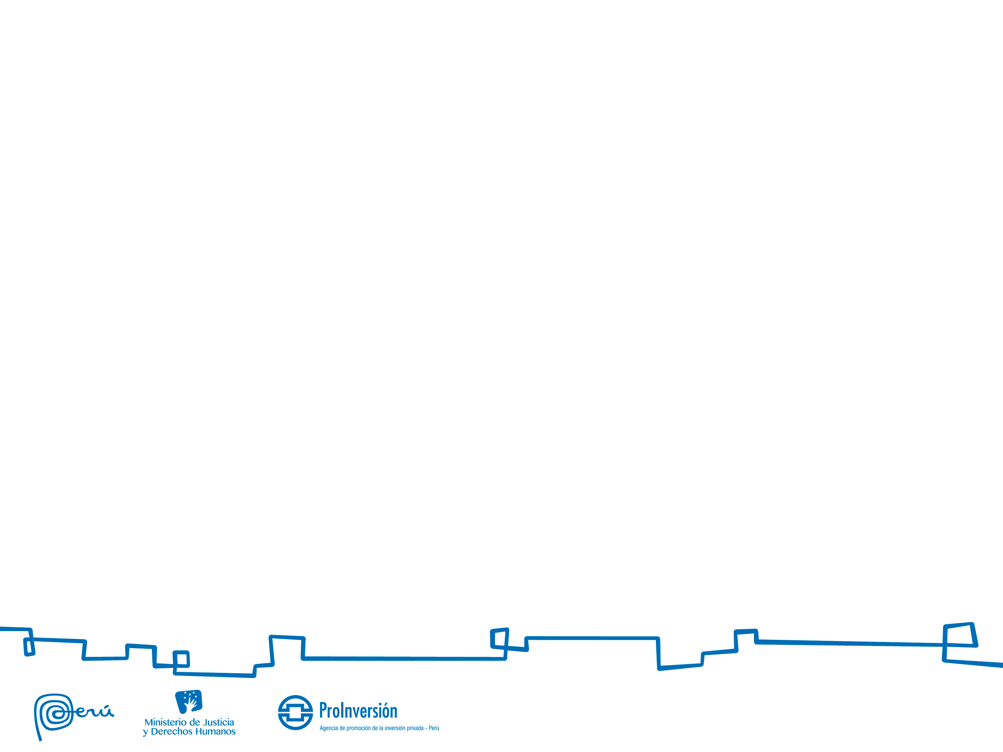
PROJECT’S DESCRIPTION
CONTRACTOR | Ministry of Justice and Human Rights - MINJUS National Penitentiary Institute – INPE
OPERATOR | Exclusive Purpose Partnership – SPE created by Proponent or Awardee. It must be registered as a Trader of Telecommunications Services at Ministry of Transportation and Communications
MODALITY | Self – sustaining Earns incomes from public telephony services
TYPE AND TERM OF CONTRACT | Technological Security Services Provision for 25 years.
INVESTMENT REFERENCE AMOUNT | At least US$ 4’134,312.00 (excluding VAT), which should be perform in 2 years.
COMPETITION FACTOR | The best discount of the public telephony service Initial rates.

Slide 4
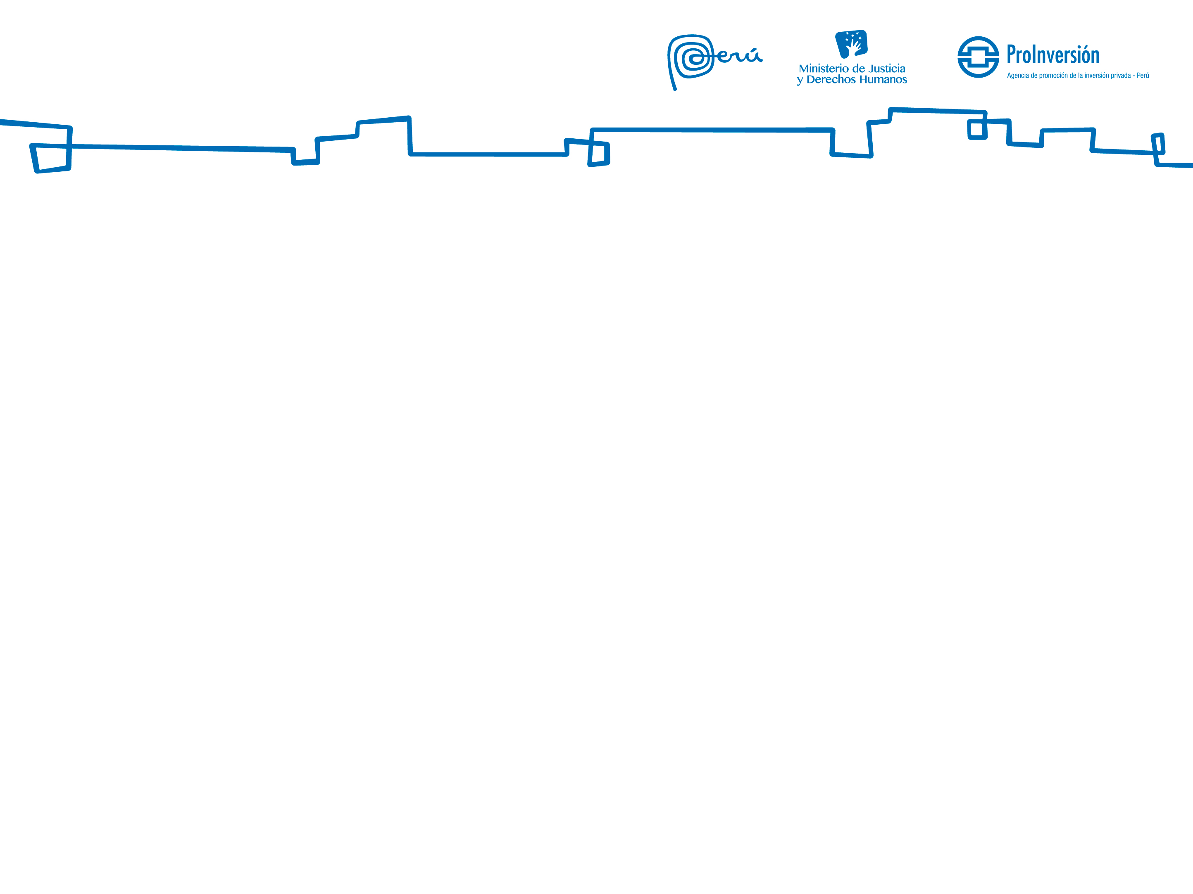
PENAL INSTITUTIONS MUST BE PERFORMED DURING DE FIRST YEAR OF CONTRACT
N° | Penal Institution (PI) | Regional Office (RO) | Prison Population
1 | PI of Cañete | Lima RO | 2,418
2 | PI of Huaral | Lima RO | 4,601
3 | PI of Ica | Lima RO | 3,312
4 | PI of Callao | Lima RO | 2,985
5 | PI of Ayacucho | Center RO - Huancayo | 2,224
6 | PI of Piura | Northern RO – Chiclayo | 2,317
7 | PI of Trujillo | Northern RO – Chiclayo | 2,653
8 | PI of Miguel Castro Castro | Lima RO | 2,543
9 | PI of Chiclayo | Northern RO – Chiclayo | 2,229
10 | PI of Huacho | Lima RO | 1,816
11 | PI of Huánuco | Eastern RO – Pucallpa | 1,967
12 | PI of Ancón II | Lima RO | 1,632
13 | PI of Pucallpa | Eastern RO – Pucallpa | 1,688
14 | PI of Cusco | South eastern RO – Cusco | 1,766
15 | PI of Ancón I | Lima RO | 1,282
16 | PI of Mujeres de Chorillos | Lima RO | 779

Slide 5
PENAL INSTITUTIONS MUST BE PERFORMED DURING DE SECOND YEAR OF CONTRACT
N° | Penal Institution (PI) | Regional Office (RO) | Prison Population
18 | PI of Chimbote | Lima RO | 1,180
19 | PI of Arequipa | Arequipa - RO South | 1,195
20 | PI of Iquitos | North eastern RO – San Martín | 935
21 | PI of Lima (San Jorge) | Lima RO | 725
22 | PI of Tarapoto (Pampas de Sananguillo) | North eastern RO – San Martín | 547
23 | PI of Cajamarca | Northern RO – Chiclayo | 797
24 | PI of Juliaca | Southern Highlands RO | 870
25 | PI of Moyobamba | North eastern RO – San Martín | 560
26 | PI of Huaraz | Lima RO | 631
27 | PI of Chachapoyas | North eastern RO – San Martín | 570
28 | PI of Chanchamayo | Center RO - Huancayo | 600
29 | PI of Tacna | Arequipa - RO South | 651
30 | PI of Lurogancho | Lima RO | 8,368
31 | PI of Puno | Southern Highlands RO | 446
32 | PI of Puerto Maldonado | South eastern RO – Cusco | 509
33 | PI of Tumbes | Northern RO – Chiclayo | 531

Slide 6
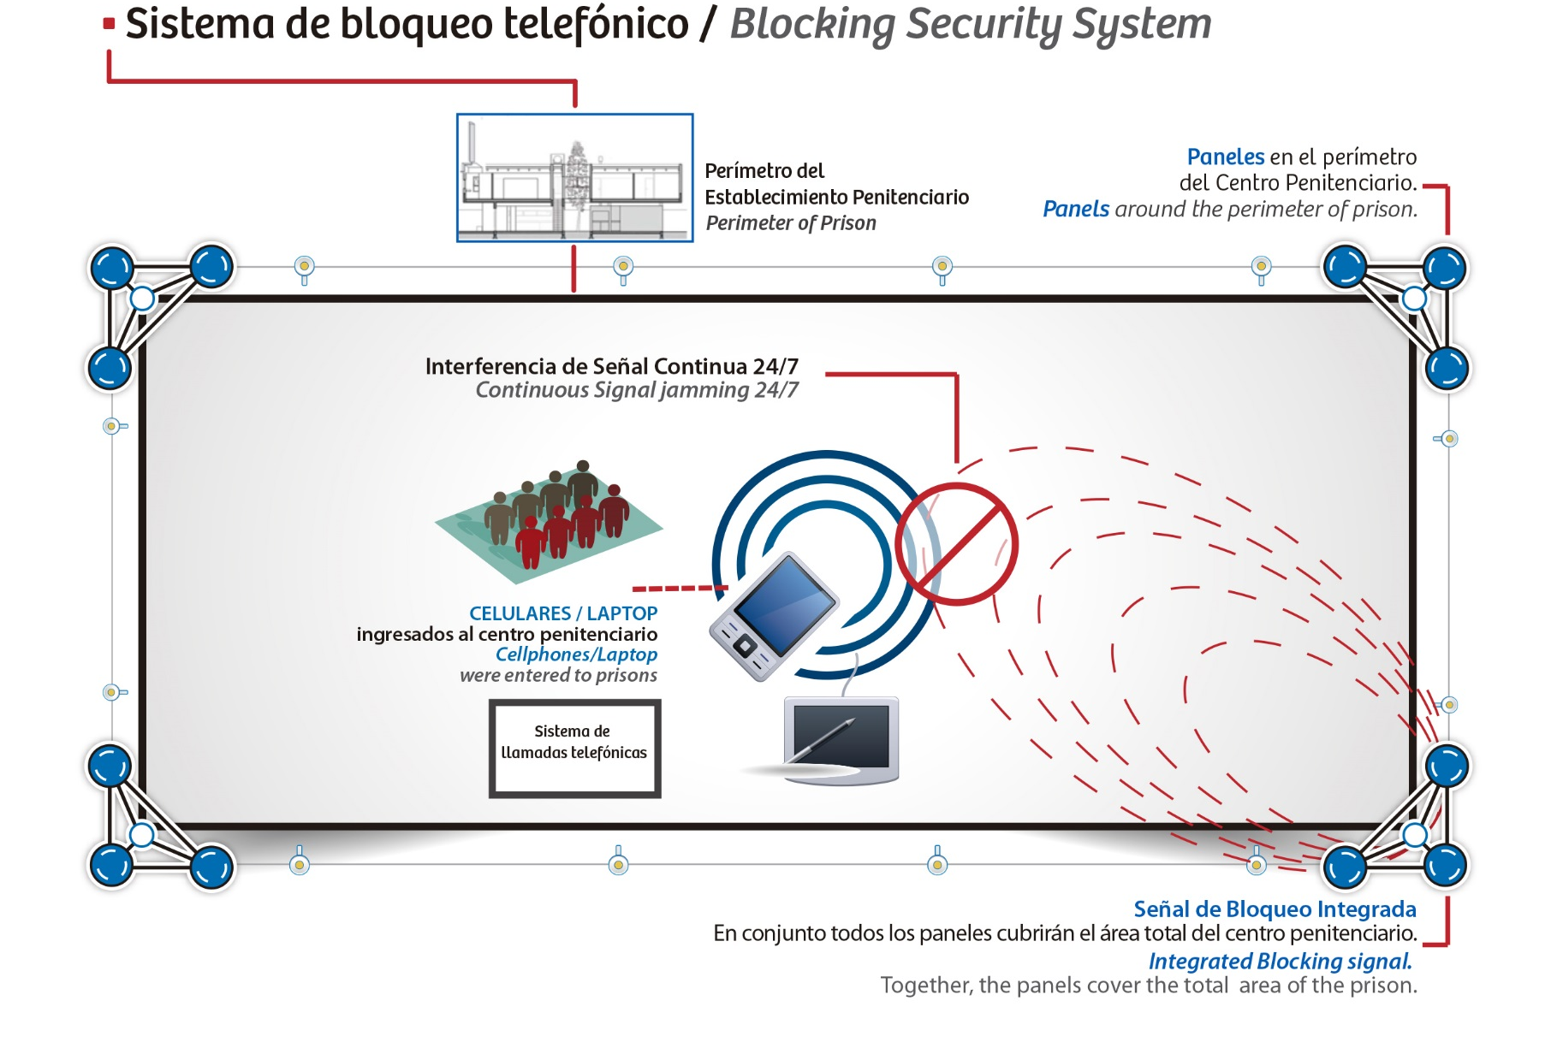
FIRST COMPONENT

Slide 7
FIRST COMPONENT
Block or Inhibit radio electric signal of:
(i) Mobile Cellular Telephony, Personal Communications Services (PCS) and Automatic Multi-Channel Selection (Trunking)
(i) other public telecommunications services that use the radio spectrum to operate in accordance with the Unique Ordered Text of the Telecommunications Law (or its amendments or supplementary provisions), or
Whenever other services or applications are classified by the INPE as a means of communication not allowed inside the PI because public safety would have been affected through them, INPE may request the blocking or inhibition of:
(ii) Wireless local area networks, knows as Wi-fi.
(ii) other applications operating in free bands established under the National Plan for Allocation of Frequencies issued by the MTC (or document updating, modifying or replacing it),

Slide 8
FIRST COMPONENT
Technological neutrality: the Peruvian Government may accept other technologies that fulfill the objectives of the Project.
The Operator must to install at least one hundred twenty seven (127) blocking’s equipment.
Equipment to be installed shall be vandal-proof, both in its structure and its installation.
Operator must to implement, at the request of INPE, technological changes needed in its security system to also block or inhibit radio signals such services or applications inside PI, without generating cost to the Government.

Slide 9
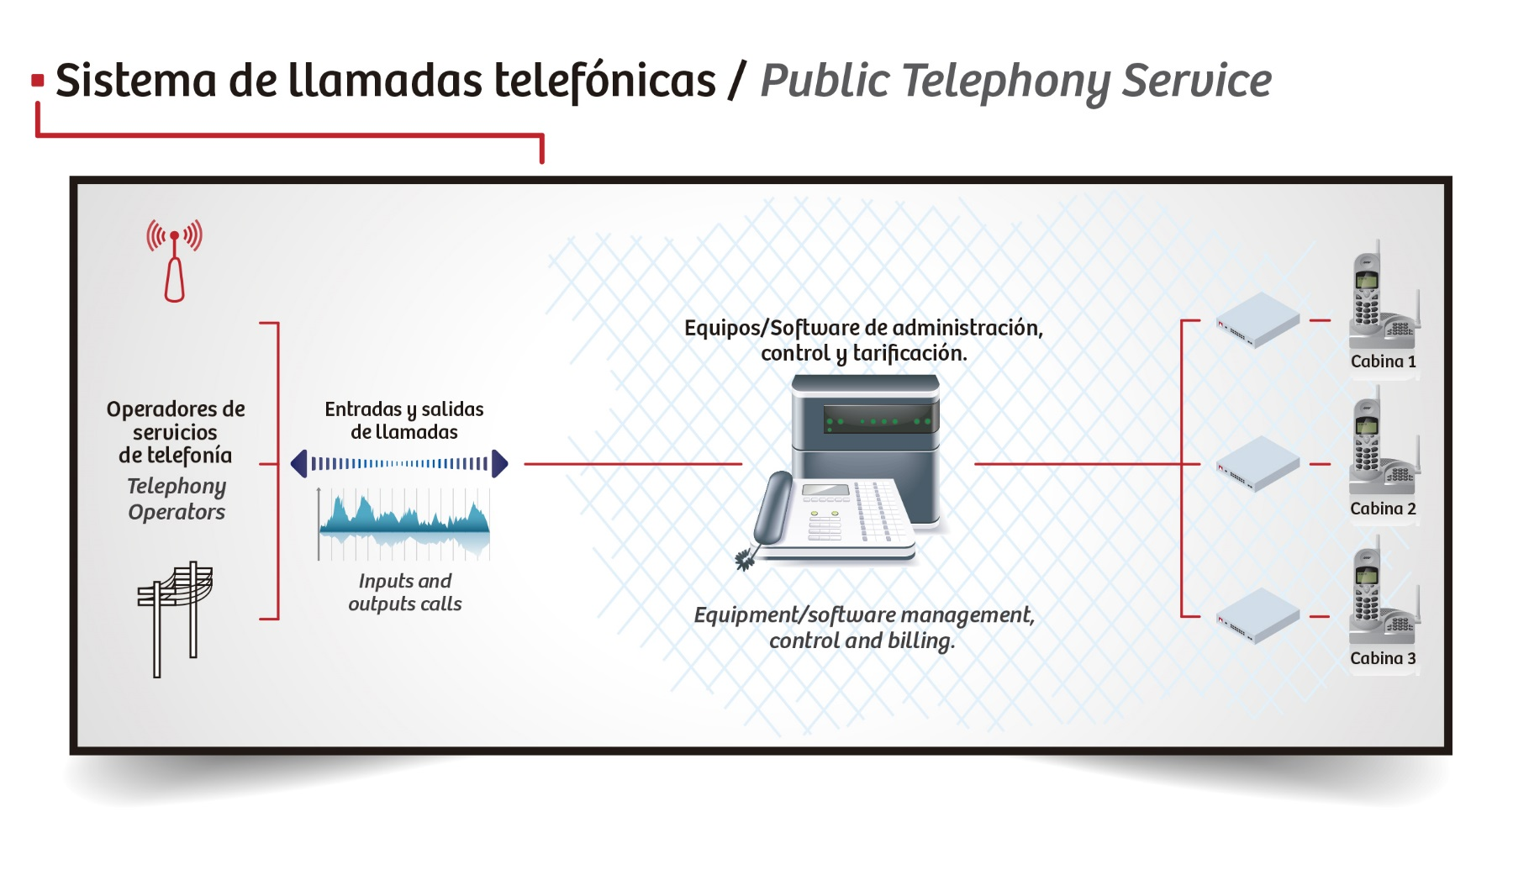
SECOND COMPONENT

Slide 10
SECOND COMPONENT
Implement the public telephone service in the 33 EP. It should include the installation of a service management software.
Equipment to be installed shall be vandal-proof, both in its structure and its installation.
The available number of minutes must be sufficient
Outgoing calls should inform the receptor about the origin of the call.
To determine number of terminals must be used methodology Erlang B.
Diffusion Program and Sale of prepaid cards

Slide 11
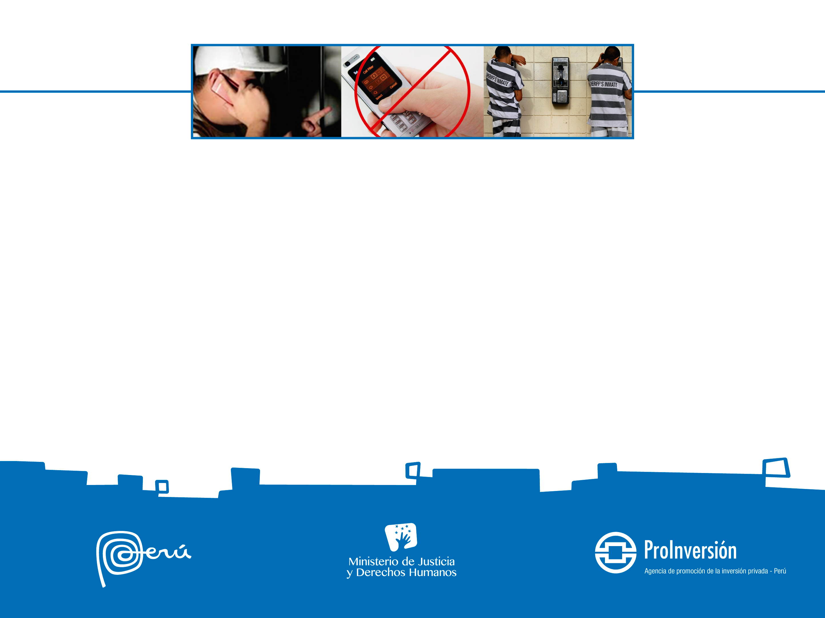
PROJECT’S INCOMES AND ADJUSTEMENT OF RATES
The project earns incomes through charging fee for payphone service. The Initial Rates will be applicable during the first 5 years of contract. After That, theses rates will be adjusted by:
Año 9
Reduced by 3%
Año 6
Reduced by 3%
Año 1
Initials Rates
Año 12
Reduced by 2.75%

Slide 12
INITIALS RATES

Slide 13
OPERATOR’S PAYEMENTS
Operator must to constitutive a Reserve Fund from a percentage of gross incomes from the operation (excluding VAT). This percentage shall be:
From Reserve Fund, a Guarantee Fund against Damage cause by Vandalism will be constituted, up to U.S. $ 483,000.00 per year.
The purpose of this fund will be to cover annually any additional investment that the Awardee will have to perform in case of acts of vandalism carried out by inmates against property equipment installed as part of the Project, up to the maximum amount. If investments over that amount were required, they will be charged to the Awardee.
Year 9 – 11
2.75%
Year 6 – 8
5.5%
Year 1- 5
8.5%
Year 12 – 25
0%

Slide 14
PRE QUALIFICATION REQUIREMENTS
Expression of Interest:
Within the period of 90 days from the publication
Submit Letter of Expression of Interest
Bid Bond of Expression of Interest (Bid Security) $ 100,000.00
Legal Requirements:
Company incorporated in their country of origin
Accreditation of powers and / or authority of its legal representative
Operational Requirements:
Public Telephones Services: at least 2 years
Installation of radio signal jammers to prevent wireless telecommunications. (to credited directly or through an equipment manufacturer - letter of commitment): at least 1 experience.
Financial Requirements:
Must prove to have a minimum net equity of U.S. $ 2'000, 000.00
It can add up the net worth of each of the companies comprising the consortium or through a related company to the participant

Slide 15
PROCESS STEPS
Pre qualification
Public Bid:
Tender and Competition Factor
Award and Contract Signing
Expression of Interest
Maximum Date: January 17th, 2014

